Slide 1

Health Roof
CAPSTONE PROJECT
FALL SEMESTER 2022-23
Review 2
All in One Solution

Slide 2
Guided By- Prof. D.Sumathi Mam
Done By-​
Y.Avinash Mani Kiran – 19BCE7466​
S.Lakshmi Prasanna – 19BCE7317​
M.Amulya - 19BCE7752

Slide 3
Methods used
Customised CNN
VGG – 16
Random Forest
XGBoost

Slide 4
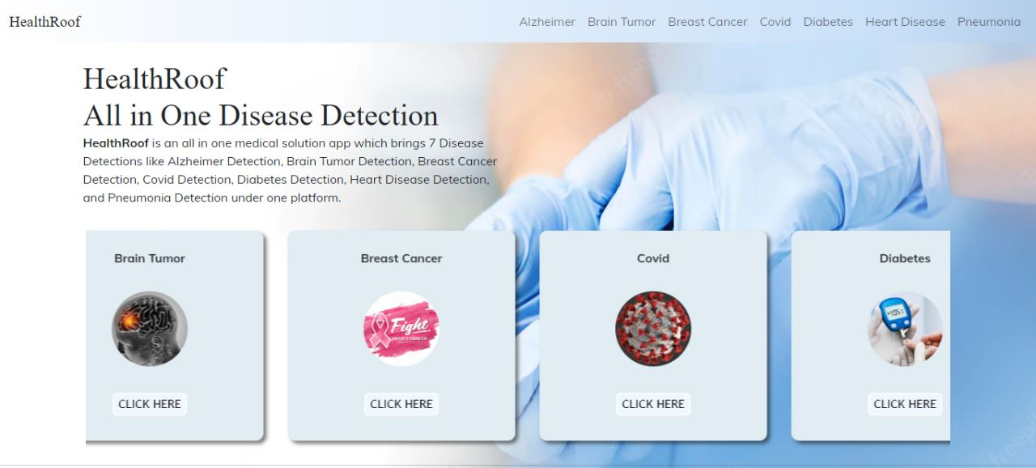

Slide 5
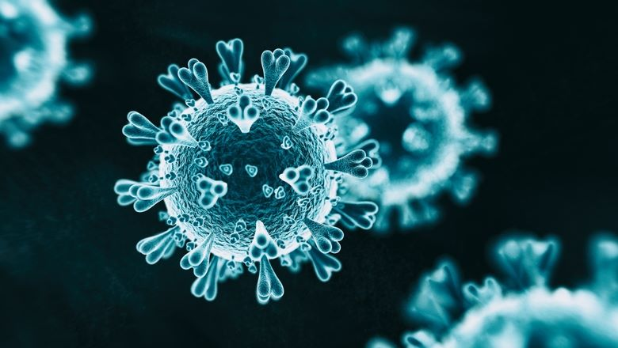
Covid-19 Detection
Most Common Symptoms: Fever,Dry cough,Tiredness
Covid 19 affects different people in different ways.
Less Common Symptoms: Aches and pains ,Sore throat ,Diarrhea,Conjunctivitis ,Headache,Loss of taste or smell
Most infected people will develop mild to moderate illness and recover without hospitalization.

Slide 6
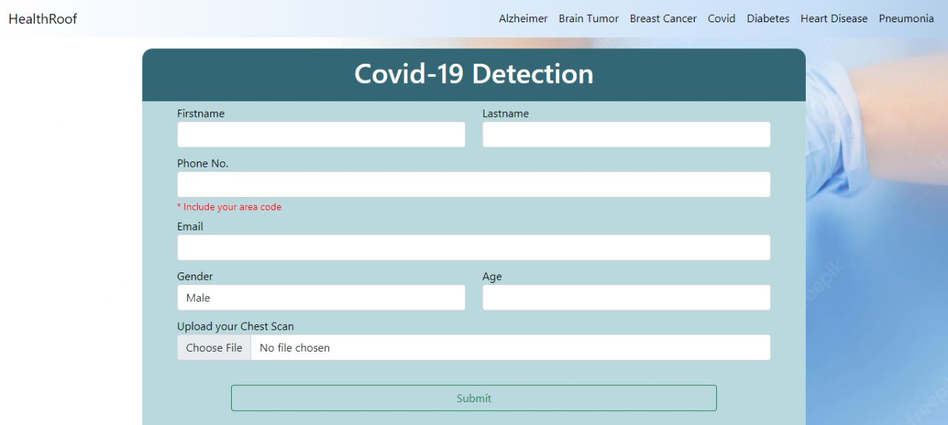

Slide 7
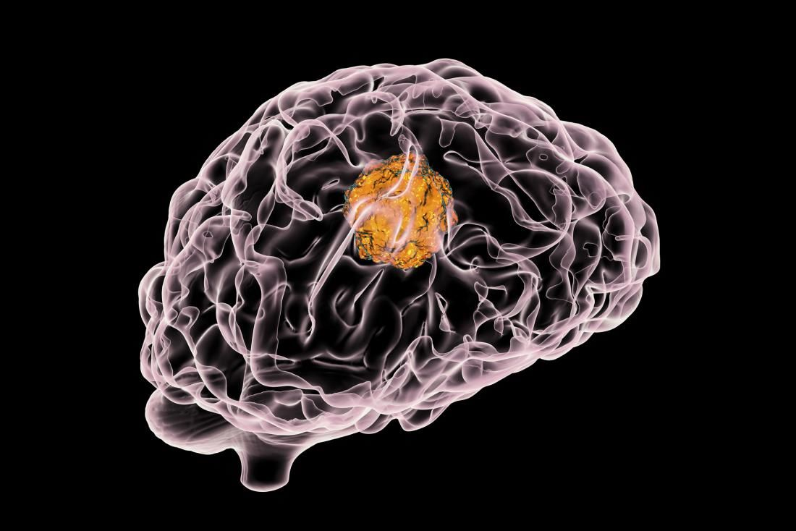
Brain Tumour Detection
Brain tumors can be cancerous (malignant) or noncancerous (benign).
Tumors can start in the brain, or cancer elsewhere in the body can spread to the brain.
When benign or malignant tumors grow, they can cause the pressure inside your skull to increase. This can cause brain damage, and it can be life-threØ
Symptoms are:new or increasingly strong Headaches ,blurred vision,loss of balance,confusion and seizures ,in some cases, there may be no symptoms

Slide 8
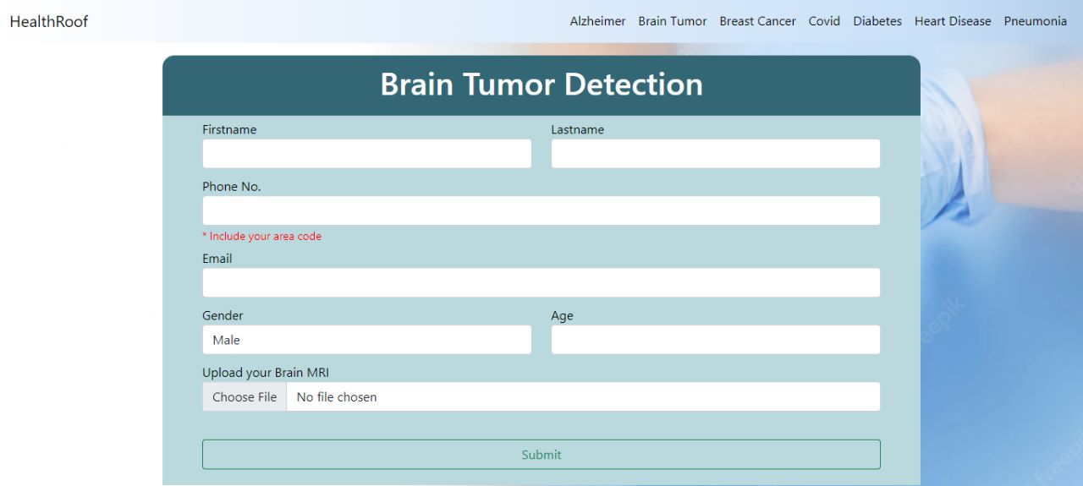

Slide 9

Breast Cancer Detection
Cancer that forms in the cells of the breast .
Breast Cancer can occur in women and rarely in men.
Breast cancer survival rates have increased, and the number of deaths associated with this disease is steadily declining, largely due to factors such as earlier detection, a new personalized approach to treatment and a better understanding of the disease.
Symptoms of Breast Cancer: a lump in the breast,bloody discharge from the nipple,changes in the shape or texture of nipple or breast.,redness or pitting of the skin over your breast, like the skin of an orange

Slide 10
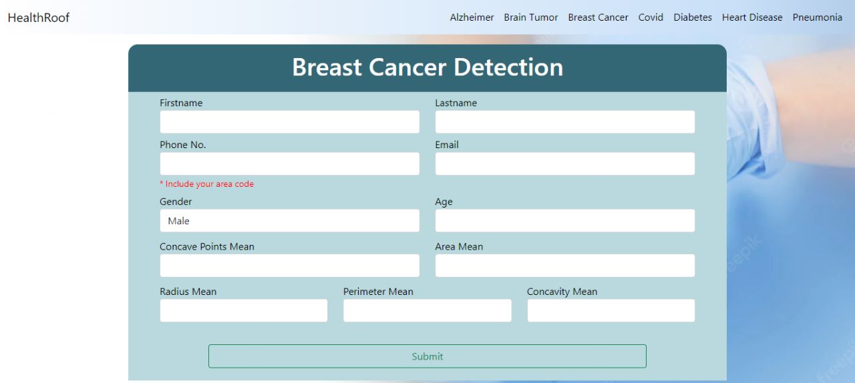

Slide 11
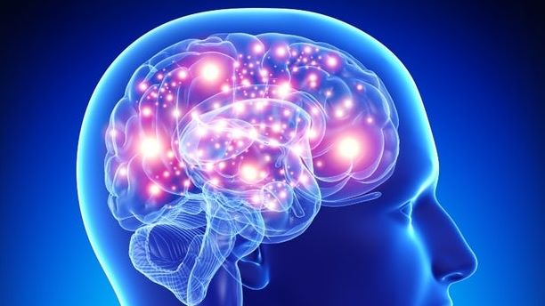
Alzheimer Detection
Progressive disease that destroys memory and other important mental functions.
Brain Cell connections and the cell themselves degenerate and die, eventually destroying memory and other important mental functions.
Memory loss is the key symptom of Alzheimer disease.
Early signs include difficulty in remembering recent events or conversations.
As the disease progress memory impairments worsen and other symptoms develop.
There is no treatment that cures Alzheimer's disease or alters the disease process in the brain.

Slide 12


Slide 13
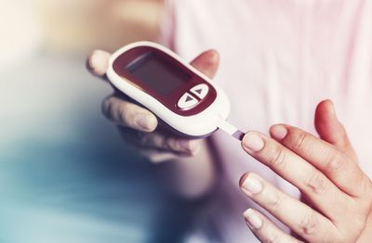
Diabetes Detection
Diabetes is a disease that occurs when your blood glucose, also called blood sugar, is too high. Also known as blood sugar.
Symptoms include: increased thirst ,frequent urination,hunger,fatigue,blurred vision.In some cases , there may be no symptoms.
Although diabetes has no cure, you can take steps to manage your diabetes and stay healthy.

Slide 14
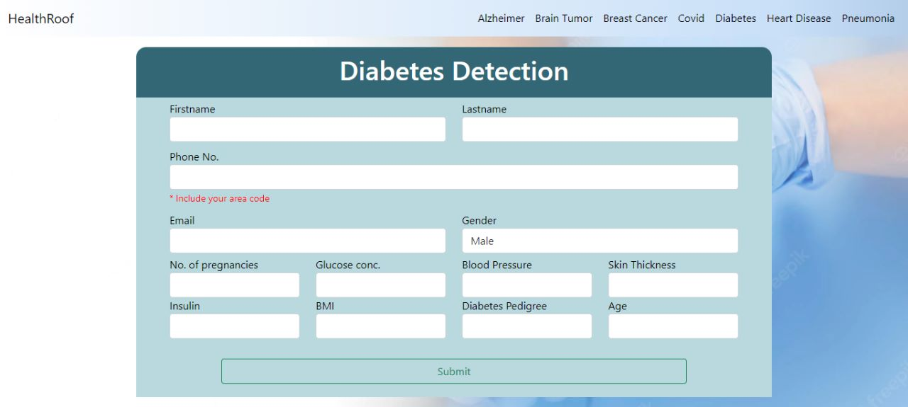

Slide 15
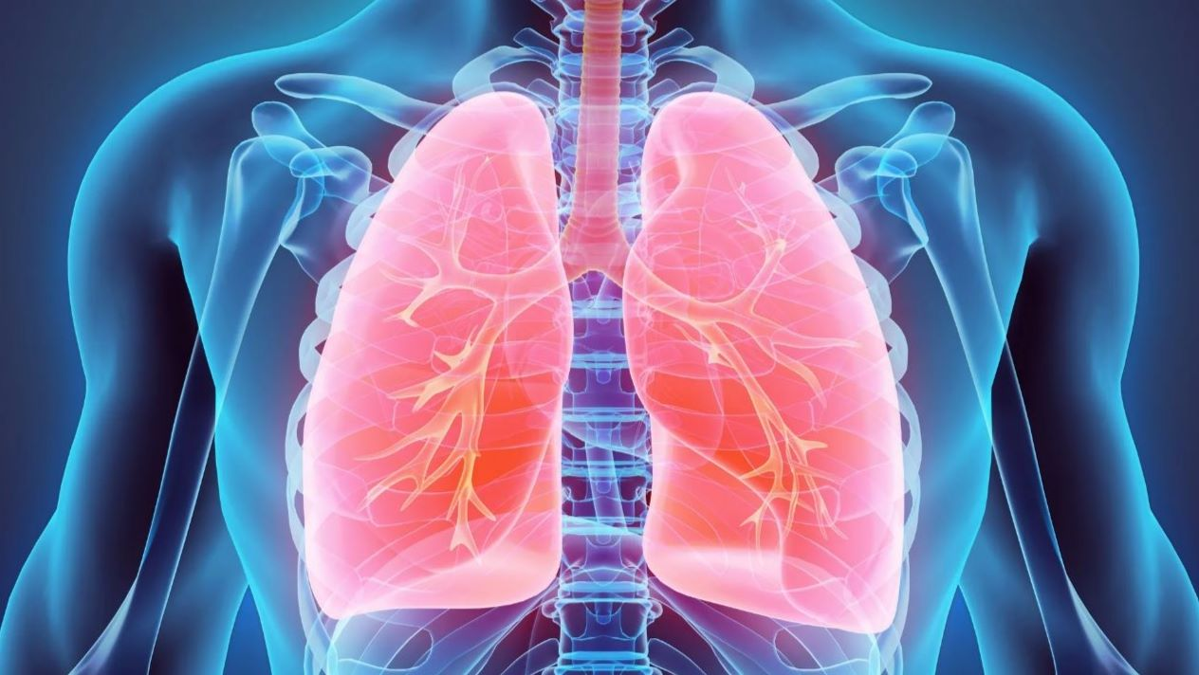
Pneumonia Detection
Infection that inflames air sacs in one or both lungs which may fill with fluids.
With pneumonia the air sacs may fill with fluid or pus.
It is most serious for infants and young children, people older than age 65, and people with health problems or weakened immune systems.
Symptoms of pneumonia:Coughing that may produce phlegm,Fever,Shortness of breath,Sweating or chills,Nausea or vomiting,Loss of appetite

Slide 16
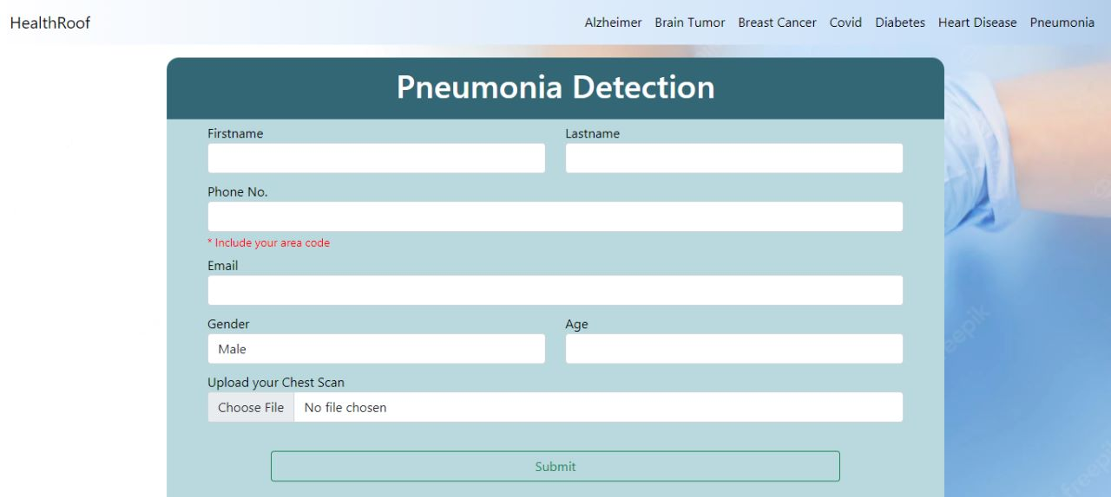

Slide 17
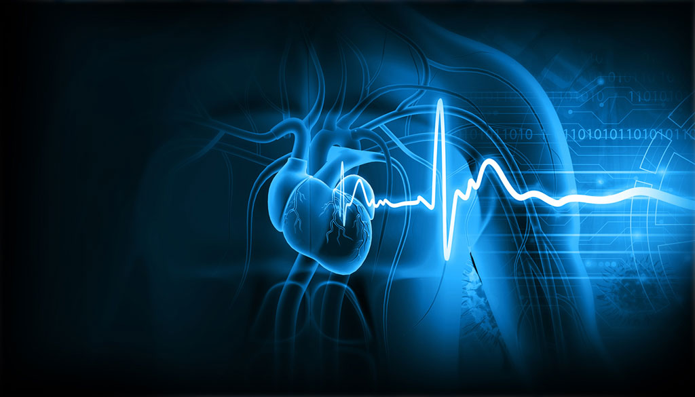
Heart Disease Detection
Heart disease refers to any conditions affecting the heart.
Heart disease describes a range of conditions that affect your heart. Heart diseases include:Blood vessel disease, such as coronary artery disease,Heart rhythm problems (arrhythmias),Heart defects you're born with (congenital heart defects),Heart valve disease,Disease of the heart muscle,Heart infection
Signs and symptoms can include:Chest pain, chest tightness, chest pressure and chest discomfort (angina),Shortness of breath,Pain, numbness, weakness or coldness in your legs or arms if the blood vessels in those parts of your body are narrowed,Pain in the neck, jaw, throat, upper abdomen or back
Unlike cardio vascular diseases , which includes problem with the entire circulatory system, heart diseases affects only heart.

Slide 18
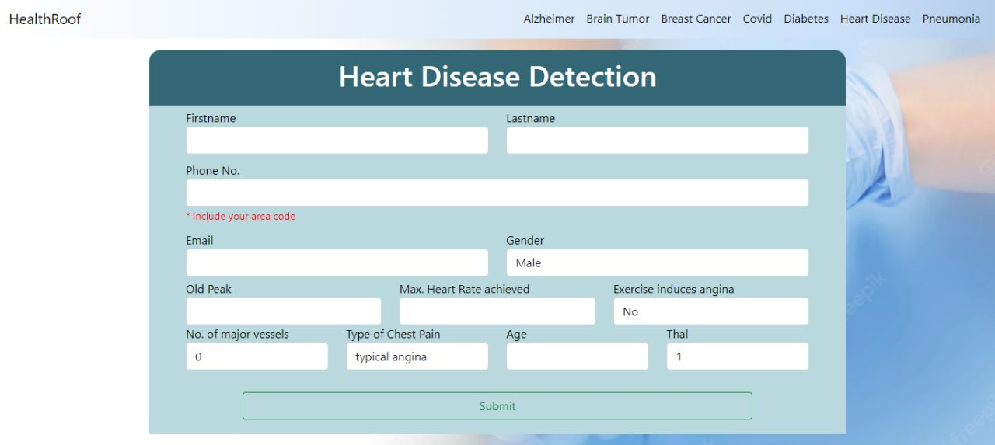

Slide 19
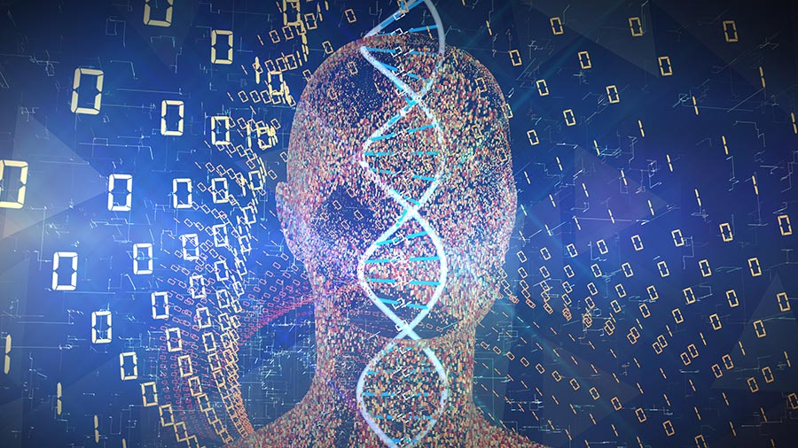
THANK YOU

